Slide 1
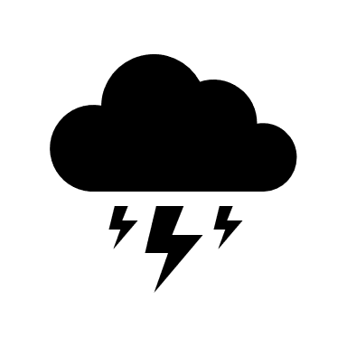
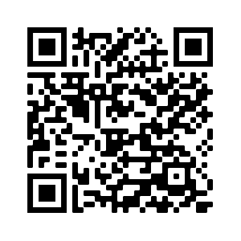
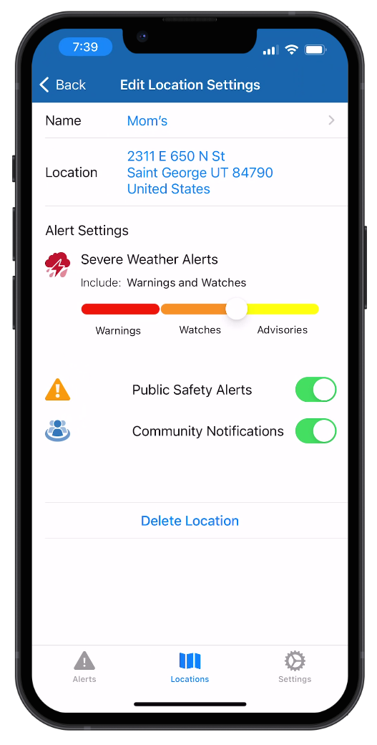
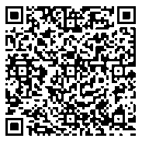
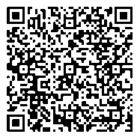
County or City Name
COMMUNITY NOTIFICATIONS
Powered By
Seconds matter in an emergency.
Receive life-saving emergency alerts from local public safety agencies, advanced warning of severe weather, and community notifications that impact you and your family.
Sign up to choose when and how you receive alerts (text, email, voice and mobile app options are available).
SAMPLE
3 Ways to Sign Up:
Scan this QR code or visit:
________.myfreealerts.com
Text __________ to 38276
Download the myAlerts app (QR codes below)

